Slide 1
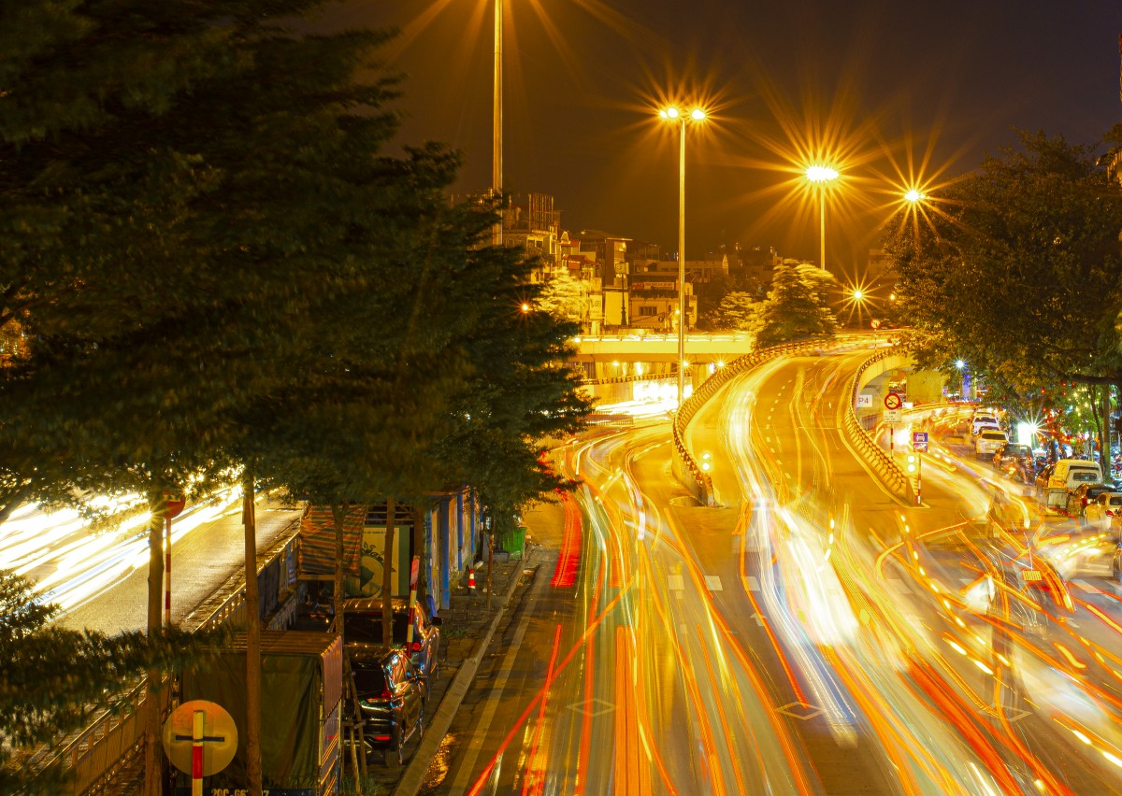
Smart Street Lighting: Enhancing Urban Efficiency and Safety

Slide 2


Acknowledgement
The British College
University of West of England(UWE)
CCA Department
Department of Cyber Security and Digital Forensics
Faculty Members
Mr. Ujjwal Koirala

Slide 3

Table of Content
Evolution of Street lights
Introduction to smart Street lights
Working mechanism
Connectivity and IoT
Advantages
Real-World Impact
Navigating Challenges
solutions
Envisioning the Future
Conclusion

Slide 4
Evolution of street-lights
Arch lamps and Incandescent bulbs
Ancient lamps
Gas lamps
Hight Pressure Sodium Lamps
Smart Street Lighting
LED Technology
Metal Halide Lamps

Slide 5

Introduction to Smart Street Light
A smart streetlight is an advanced outdoor lighting system that includes sensors and connection that is designed to quickly adapt to changing conditions, optimize energy consumption, and contribute to smart city projects for enhanced sustainability and safety.

Slide 6
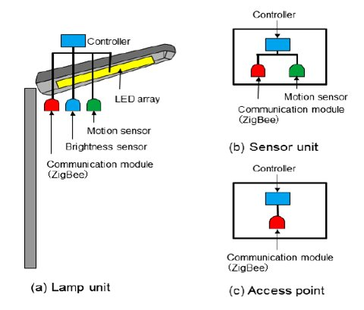
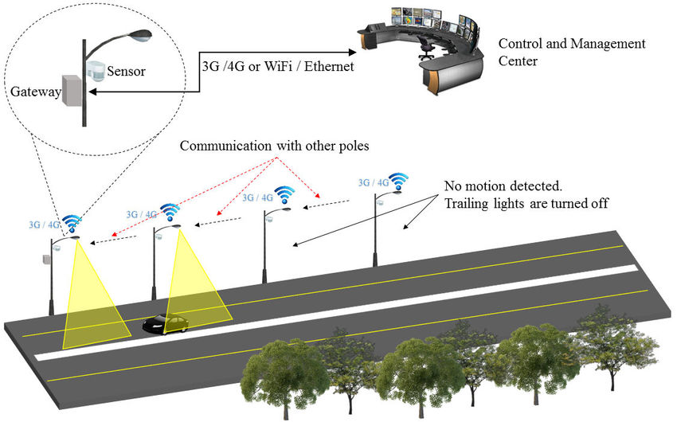
Working mechanism

Slide 7
Data Acquistion
Types of sensors used are:
1. camera
2. motion sensor
3. ambient light sensor
4. Air quality sensor

Slide 8
Data Transmission
LoraWan
Zigbee
Long range
Suitable for large urban areas
Low power consumption
Low-power
Short range
Mesh network where each street light act as a node
Wireless sensor node ( WSN)
A crucial endpoint for data transmission which act as a node for communication hub.

Slide 9
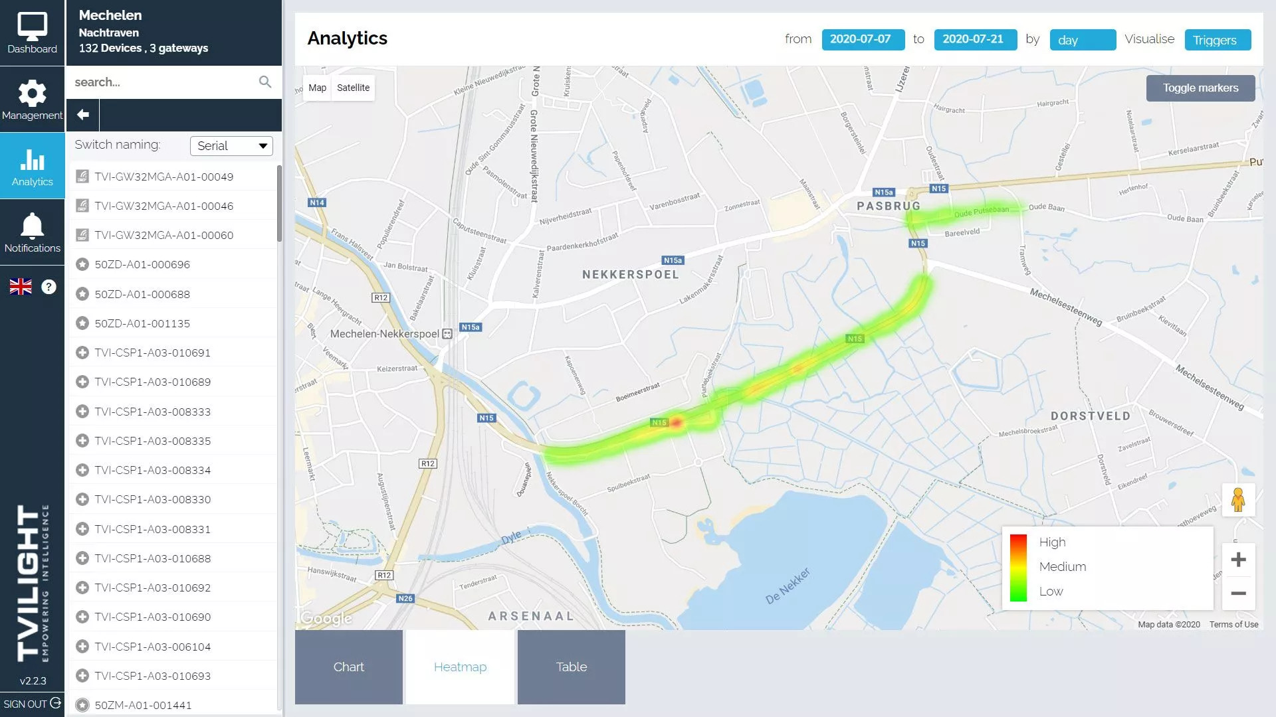
Data visualization
Heat map for traffic intensity by detecting human and vehicles for specific location as shown in figure:

Slide 10
Data processing and management
Central control unit
ARM Cortex –M CPU processor
Command center for managing sensor data to ensure all light work together efficiently.
Real time decision making based on sensor.
Speed and efficiency in processing information.
Microcontroller
For executing complex algorithm for energy optimization, fault detection and adaptive lighting.

Slide 11
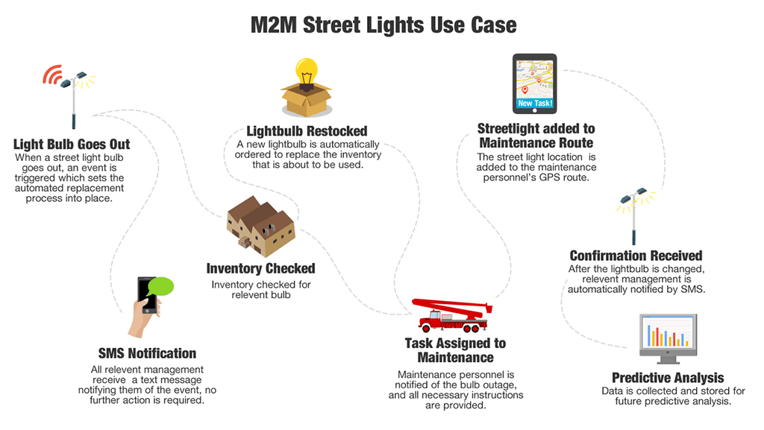
Data analytics
Use of machine learning for pattern detection and abnormalities
Example:
Predictive maintenance: Sensors monitor parameters; machine learning predicts faults for proactive maintenance.

Slide 12
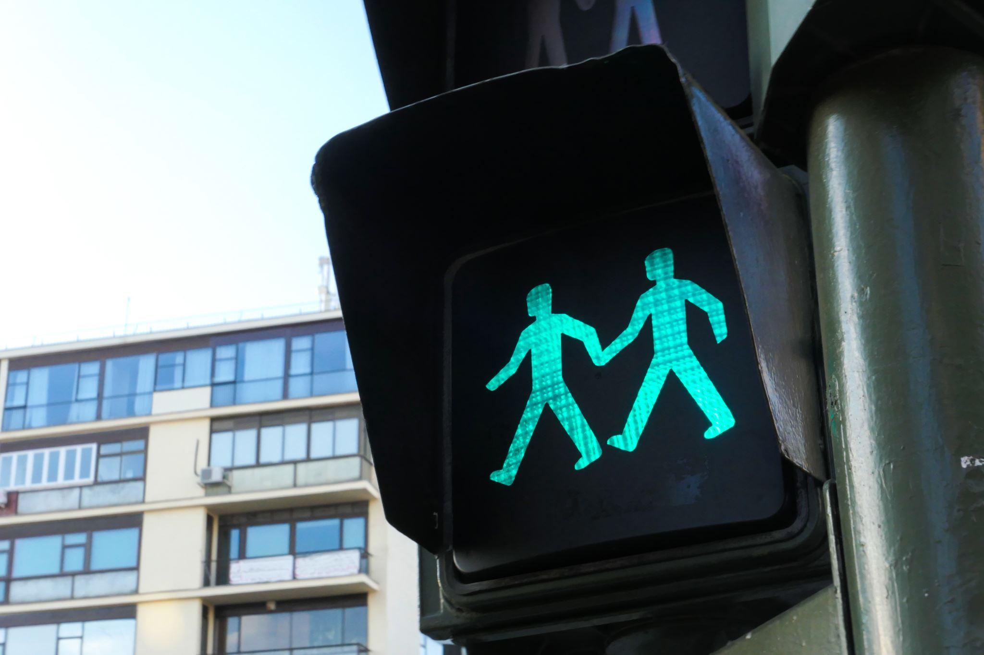
Connectivity and IoT
IoT enables smart streetlights to communicate with traffic systems in real time, ensuring dynamic adjustments during peak traffic for optimized flow and enhanced urban efficiency.

Slide 13

Advantages
Energy efficiency
Remote Monitoring control
Enhanced safety
Reduce light pollution
Longer lifespan
Improved Traffic Management
This Photo by Unknown author is licensed under CC BY-NC-ND.

Slide 14

Real world impacts
Barcelona's Energy-Efficient Transformation:
Achievement: Achieved a 30% reduction in energy consumption through dynamically controlled smart streetlights.
Los Angeles' Enhanced Safety Measures:
Achievement: Implemented motion sensors and adaptive lighting, resulting in reduced crime rates.
Singapore's Light Pollution Management:
Achievement: Successfully managed light pollution through intelligent lighting systems.

Slide 15
Navigating challenges
Initial Costs
Cybersecurity Concerns
Integration Issues

Slide 16
Solutions
Public-Private Partnerships
Strong Cybersecurity Measures
Uniformity Efforts

Slide 17

Envisioning the future
Solar-Powered Streetlights
AI-Driven Predictive Maintenance
Deeper Integration with Smart City Ecosystems.

Slide 18

Conclusion
Smart Street Lighting is more than simply lights; it is about directing communities toward a smarter, safer, and more sustainable future. We're not only lighting streets by adopting technologies like IoT and AI; we're illuminating a way to linked effective urban living.

Slide 19
References
‘ Modernizing Street Light Infrastructure Challenges and Opportunities ’ (no date) Utilities One [online]. Available from: https:// utilitiesone.com/modernizing-street-light- infrastructure-challenges-and-opportunities. [Accessed 3 January 2024].
admin (2022) How to build Smart Cities using Heatmaps from Smart Street Lights Tvilight. 1 December 2022 [online]. Available from: https://tvilight.com/how-to-build-smart-cities-using-heatmaps-from-smart-street-lights/ [Accessed 5 January 2024].
‘The evolution of public lighting, from torches to smart services’ (2023) Energy Cities. 1 June 2023 [online]. Available from: https://energy-cities.eu/the-evolution-of-public-lighting-from-torches-to-smart-services/. [Accessed 5 January 2024].
Lewis, S. (2019) What is a smart streetlight? IoT Agenda . December 2019 [online]. Available from: https://www.techtarget.com/iotagenda/definition/smart-streetlight [Accessed 1 January 2024].

Slide 20

Thank you!!
Any Queries?

